Slide 1



NAIVE BAYES CLASSIFIER
IN MACHINE LEARNING

Slide 2

What is Naive Bayes?
Naive Bayes Classifier works on the principles of Conditional Probability as given by Baye‘s Theorem.
It is based on Supervised Machine Learning.
It is a probabilistic classifier, which means it predicts on the basis of the probability of an object.

Slide 3

What is Independent Event?
Rolling a Die: {1, 2, 3, 4, 5, 6}
Prob(1): 1/6
Prob(2): 1/6
Prob(3): 1/6
Rolling a Die

Slide 4

What is Independent Event?
Tossing a coin: {H, T}
Prob(H): 1/2
Prob(T): 1/2
Tossing a coin

Slide 5
What is Dependent Event?
There is a Box. In this Box there are 3 Red Ball and 2 Green Ball.

Slide 6
What is Dependent Event?
Event: We choose a Red Ball.
Probability: Prob(Red)=3/5

Slide 7
What is Dependent Event?
Event: Now We choose a Green Ball.
Probability: ????

Slide 8
What is Dependent Event?
Remaining Red Ball: 2
Remaining Green Ball: 2

Slide 9
What is Dependent Event?
Event: Now We choose a Green Ball.
Probability: Prob(Green)=2/4

Slide 10
What is Dependent Event?
First we choose a Red Ball and after that a Green Ball.
Prob (R and G): Prob(R) * Prob (G/ R)

Slide 11
What is Dependent Event?
First we choose a Red Ball and after that a Green Ball.
Prob (R and G): Prob(R) * Prob (G/ R)
Conditional Probability

Slide 12
Baye’s Theorem
Prob (R and G): Prob(R) * Prob (G/ R)
Prob (A and B): Prob(A) * Prob (B/ A)
Prob (Band A): Prob(B) * Prob (A/ B)

Slide 13
Baye’s Theorem
Prob (A and B) = Prob (Band A)
Prob(A) * Prob (B/ A) = Prob(B) * Prob (A/ B)
Prob (B/ A) = Prob(B) * Prob (A/ B)
Prob(A)
Probability of B when A is given.

Slide 14
Baye’s Theorem
x1 | x2 | x3 | y
 |  |  | NO
 |  |  | YES
 |  |  | YES
What will be the Probability of y?

Slide 15
Baye’s Theorem
Prob (B/ A) = Prob(B) * Prob (A/ B)
Prob(A)
Prob (Yes/ x1,x2,x3) = Prob(Yes) * Prob (x1,x2,x3/ Yes)
Prob(x1,x2,x3)
Prob (No/ x1,x2,x3) = Prob(No) * Prob (x1,x2,x3/ No)
Prob(x1,x2,x3)

Slide 16
Baye’s Theorem
Prob (Yes/ x1,x2,x3) = Prob(Yes) * Prob (x1,x2,x3/ Yes)
Prob(x1,x2,x3)
Constant
Prob (No/ x1,x2,x3) = Prob(No) * Prob (x1,x2,x3/ No)
Constant
Prob(x1,x2,x3)

Slide 17
Baye’s Theorem
Prob (Yes/ x1,x2,x3) = Prob(Yes) * Prob (x1,x2,x3/ Yes)
Prob (Yes/ x1,x2,x3) = Prob(Yes) * Prob (x1/Yes)* Prob(x2/Yes)* Prob(x3/Yes)
Prob (No/ x1,x2,x3) = Prob(No) * Prob (x1,x2,x3/ No)
Prob (No/ x1,x2,x3) = Prob(No) * Prob (x1/No)* Prob(x2/No)* Prob(x3/YNo)

Slide 18
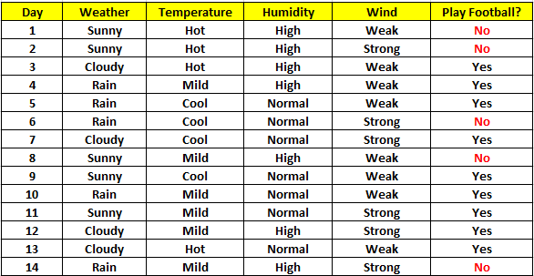
Naive Baye’s Problem -1
If the Weather is Sunny and Wind is Weak then what will happen?

Slide 19
Naive Baye’s Problem -1
Prob (Yes/ Sunny,Weak) = ???????????
Prob (No/ Sunny,Weak) = ???????????

